Slide 1
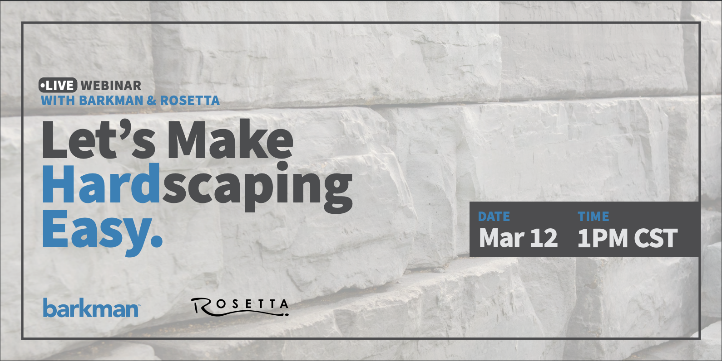

Slide 2
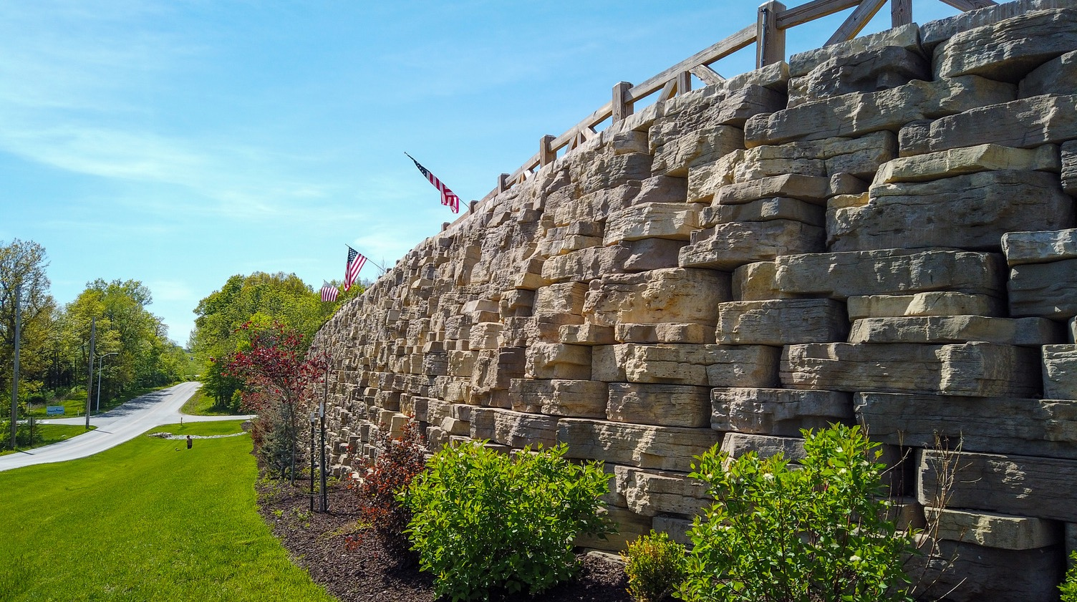
Engineering 101
With Matt Jensen, PE

Slide 3
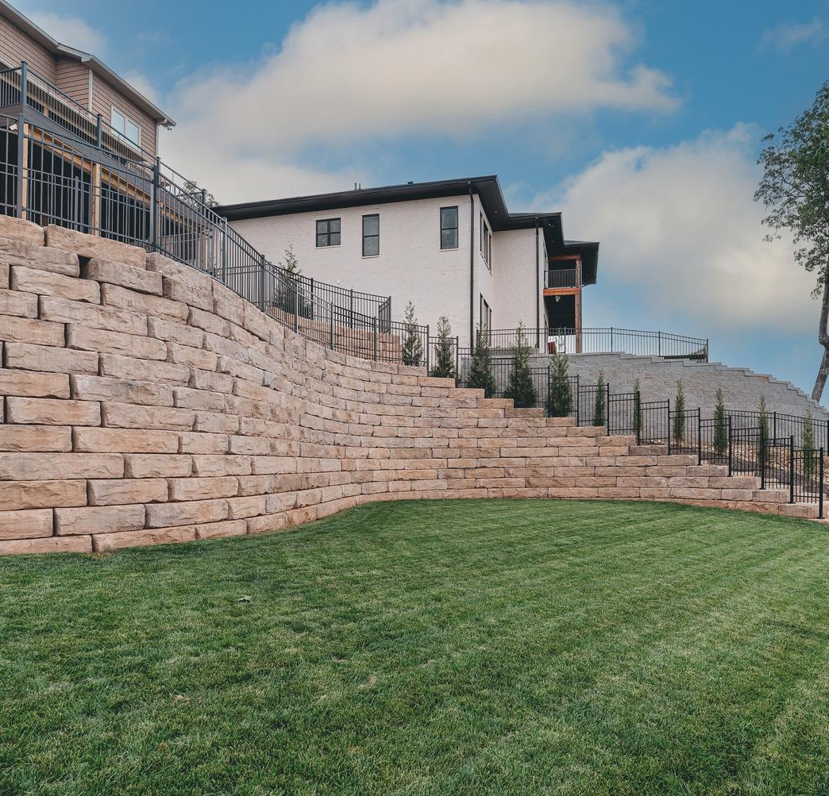
Outline
Introduction and Purpose
What is a Precast Modular Block
Design Inputs
Loads on the Wall
Stability Analysis
Detailing
Best Practices

Slide 4
What is the importance of PMB Walls?

Slide 5
Introduction and Purpose
Big blocks have been used to construct walls for ages. There is something inherently simple about stacking large blocks on top of each other that just makes sense. If the blocks are big and heavy enough, they can be used to safely support retained earth and anything else that might be on top of the wall.
Recently large precast concrete blocks, often called precast modular blocks or PMBs, have become widely available and are used to build retaining wall structures. PMB walls have been used in several innovative ways, such as constructing traditional walls, walls with large batter angles, PMB-faced structures, and freestanding walls that act as fences or barriers.
PMB units are used in public projects, commercial projects, and at private projects and even though the basic concepts are simple and PMB retaining walls are easy to construct, the engineers who design them are quite unique. They must possess a wide range of skills including a firm grasp of geotechnical engineering principles, a good working knowledge of structural engineering, an understanding of site engineering, and a strong background in construction.

Slide 6
What is a PMB?

Slide 7
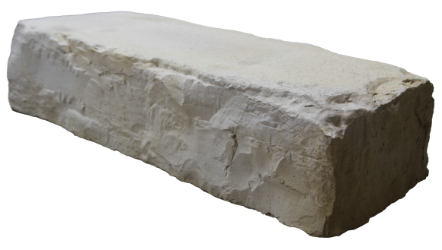
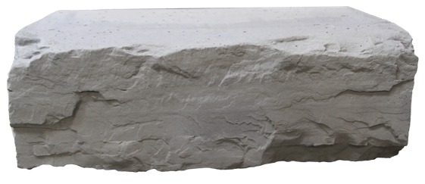
What is a Precast Modular Block?
Precast Modular Block (PMB)
  Name commonly used to describe a large retaining wall block
  Produced from first purpose, wet-cast concrete
  Produced per ASTM Standard Specification C1776 - Standard Specification for Wet-Cast Precast Modular Retaining Wall Units
  Generally have water / cement ratio of between 0.40 and 0.45
  Minimum compressive strength of 4,000 psi

Slide 8
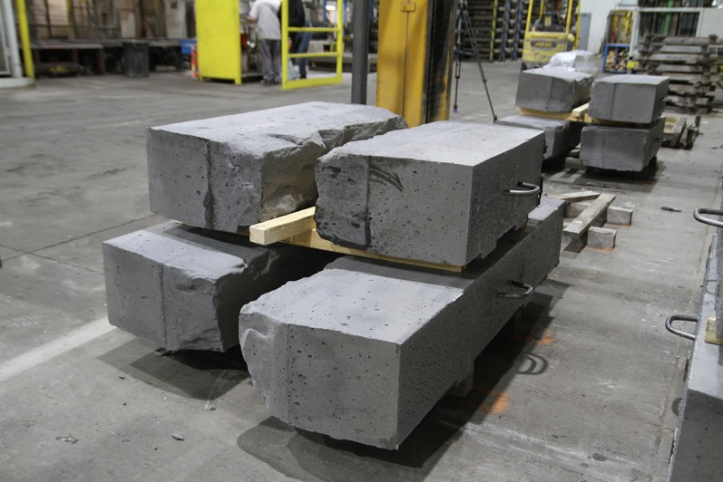
What is a Precast Modular Block?
PMB units vary in size, but generally range between a few hundred pounds to several thousand pounds each. PMB units are almost exclusively set by large construction equipment.

Slide 9
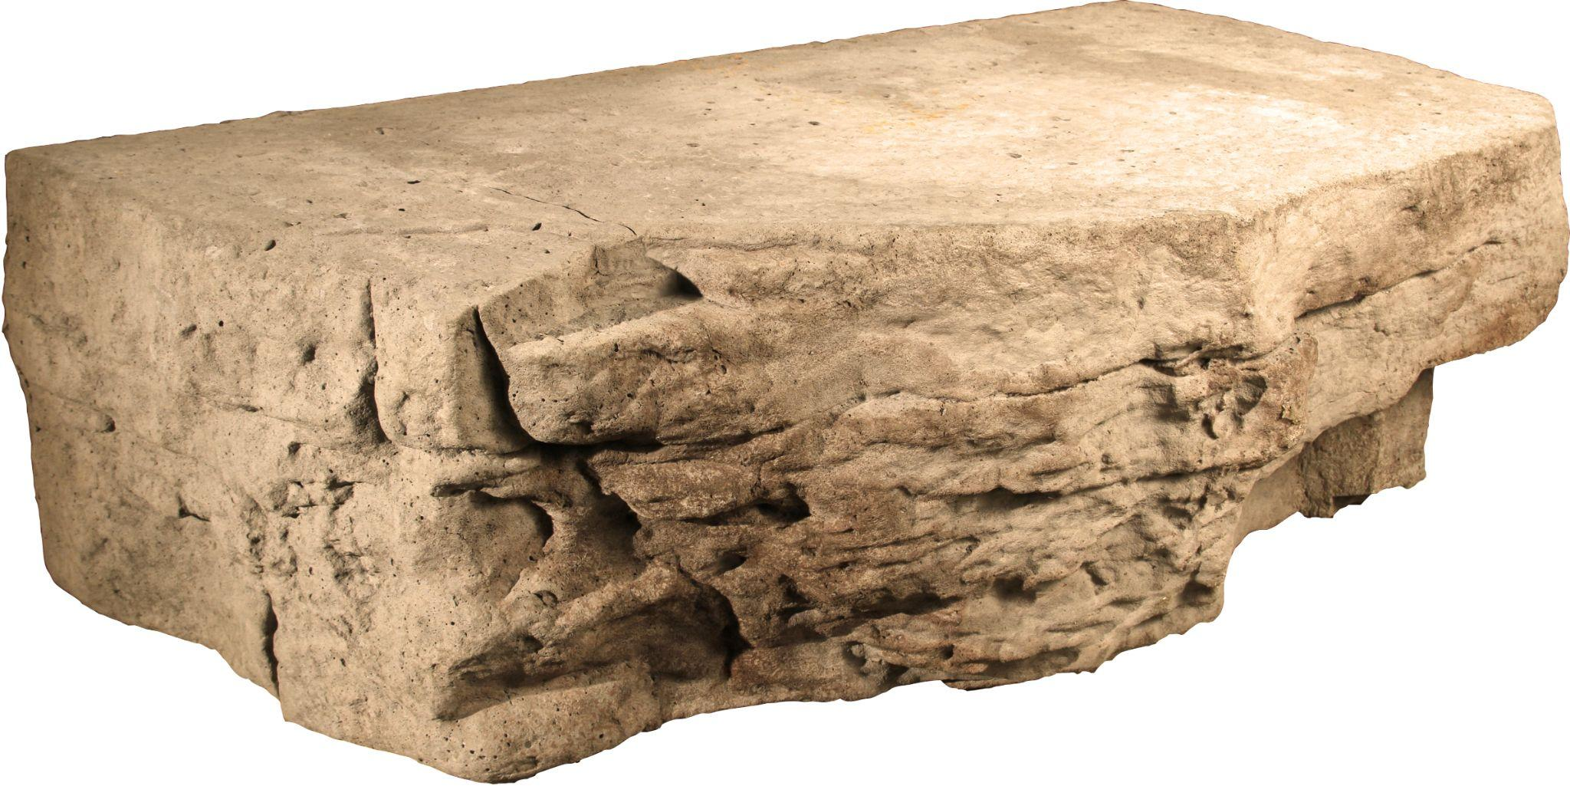
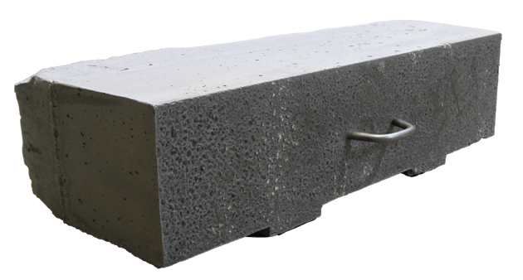
What is a Precast Modular Block?
Precast Modular Block (PMB)
  Can be
    Solid
    Slotted
    Hollow
  Often they have some form of interlocking mechanism for
    Block-to-block shear
    Establish horizontal setback between rows

Slide 10
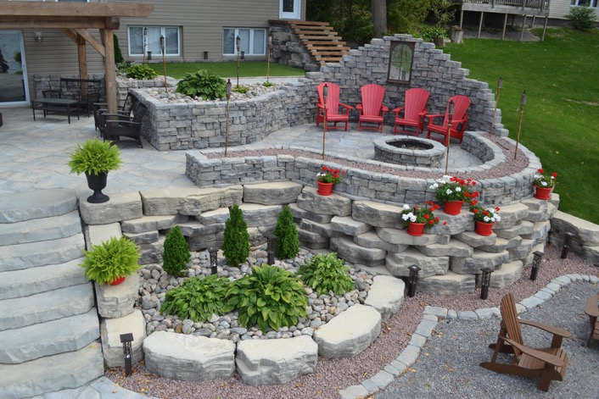
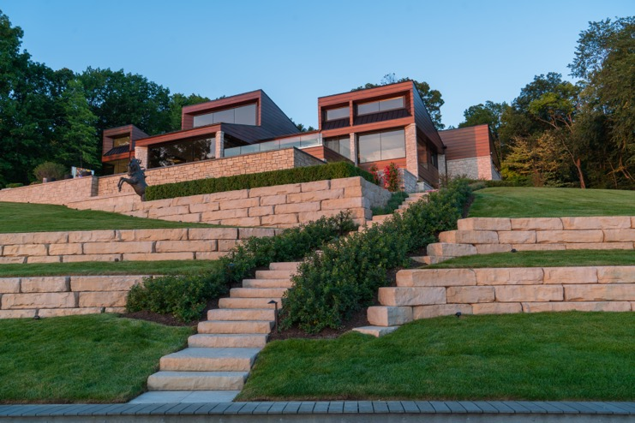
What is a Precast Modular Block?
PMB units area typically tapered on the sides to accommodate curved wall installations.
There are also special units which allow for construction of corners.

Slide 11
What are the inputs for
PMB wall design?

Slide 12
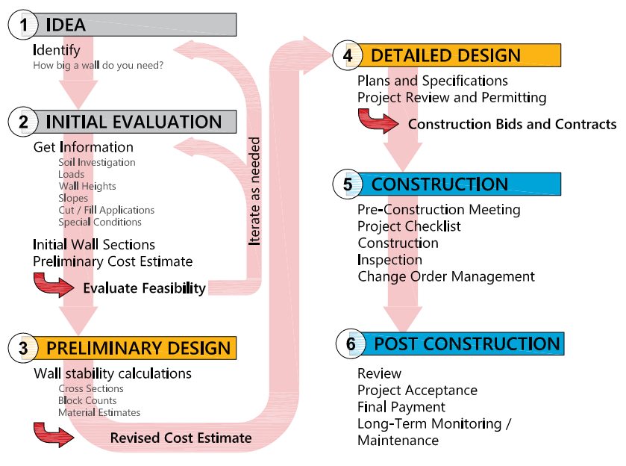
Design Inputs
Typical Steps for Designing and Construction of a Wall
Notes:
As you move through the process, cost estimates get better, the wall solution becomes optimized, and confidence in the successful completion of your project increases
Some of the steps may be combined depending on the project and the familiarity of the parties involved with PMB wall design and construction.
Proper soil investigation is critical.

Slide 13
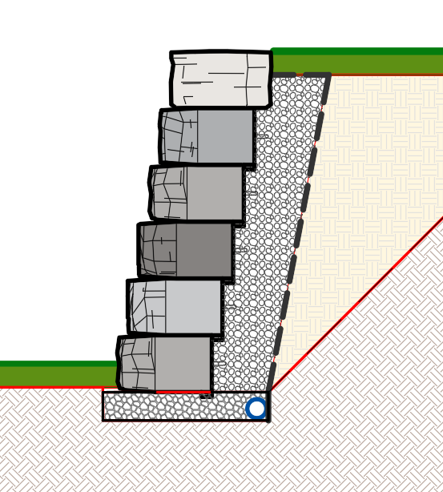
Design Inputs
Information Required to Design a Wall
  Wall Geometry and Site Grading
  Detailed Geotechnical Information
  Wall Loading
  Leveling Pad Requirements
  Design Requirements
  Water Conditions
  Unusual / Special Conditions or Requirements
  Top of Wall Requirements
  Site Utilities
Notes:
The more information available in planning and design of a retaining wall, the more likely the wall will be properly designed to meet project requirements. Design and construction of a wall with limited, incomplete, or missing information requires someone to guess at conditions. Even if missing information does not lead to a wall failure, it often results in a wall that is either underdesigned for the actual conditions and does not provide the desired level of reliability or is overdesigned and costs more than it should.

Slide 14
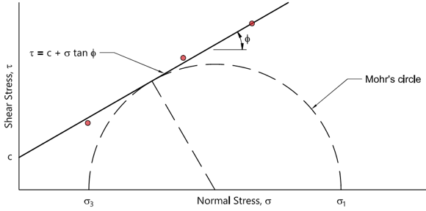
Design Inputs
Information Required to Design a Wall
  Soils
    Soils are the largest single factor that impact the wall’s design, construction, and performance.
      Unit Weight (pcf)
      Internal Angle of Friction (°)
      Cohesion (psf)
  Shear Strength
    It is the soils resistance to mass deformation from a combination of particle rolling, sliding, and crushing.
    It is measured in terms of two parameters, internal angle of friction and cohesion, both of which can be shown by plotting a Mohr-Coulomb diagram.

Slide 15
Design Inputs
Information Required to Design a Wall
  Shear Strength
    Internal angle of friction (Φ)
      Is the resistance of slip between particles in the soil. Care must be taken to use an appropriate value of internal angle of friction for fine-grained soils.
    Cohesion (c)
      Is the measure of attraction between soil particles at no normal stress.
      It changes with pore pressure and/or movement of the soil.
      As a result, most wall designers ignore cohesion in wall design.

Slide 16
Design Inputs
Information Required to Design a Wall
  Unit Weight, Density, and Compaction
Soils are made up of solids, water, and air. The proportions of each impacts the engineering behavior of the soil. Unit weight, density, and compaction are concepts that help describe soils.
    Unit weight - the total weight of the soil particles and water in a given volume.
    Relative density - Often just called density of the soil is the ratio of the soil’s in-place density to its maximum density.
      Soils, especially fill soils, can be compacted to make them denser – increasing their strength and reducing potential for settlement.
      Dense soils tend to have higher shear strength than loose soils.
      Water plays an important role in compaction of soils, with a soil being easier to compact to a higher density at a specific “optimum” water content.

Slide 17
Design Inputs
Information Required to Design a Wall
Soil Properties
  Unit Weight ( γ )
    Typical range for design
      100 pcf to 145 pcf
  Internal angle of friction ( Φ )
    Typical range for design
      15° to 40°
  Cohesion ( c )
    Typical range for design
      0 psf to 2,000+psf
      However, cohesion is typically ignored in retaining wall design
Φ: Soil Internal Angle of Friction
Poor Soils (Fines)
Good Soils (Granular)
Φ = Low
Φ = High
Silty Sand
Φ : 30°
Well Graded
Sand
Φ : 34°
Crushed Gravel
Φ : 40°
Clayey /
Silty Sand
Φ : 28°

Slide 18
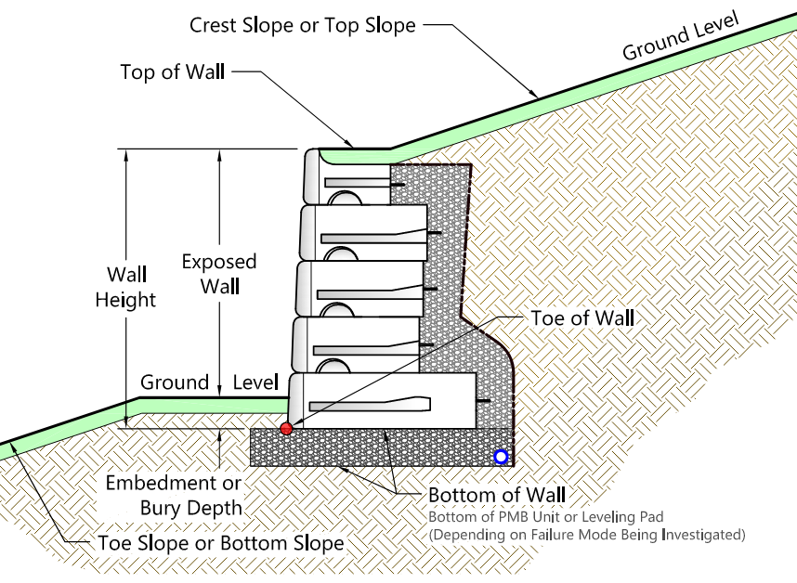
Design Inputs
Information Required to Design a Wall
  Wall Geometry - Nomenclature for PMB walls is similar to that used for most wall types.
    “Top of Wall” is defined as the top of the highest PMB unit
    “Toe of the Wall” is considered the front corner of the lowest PMB unit
    “Embedment” or “bury depth” is the height of soil in front of the wall near the toe
    Wall height is measured from the top of the wall to the bottom of the wall and includes both the exposed wall height and the embedment.
    A slope at the top of the wall is called the “crest slope” or “top slope”.
    A slope at the bottom of the wall is referred to as a “toe slope” or the “bottom slope”.

Slide 19
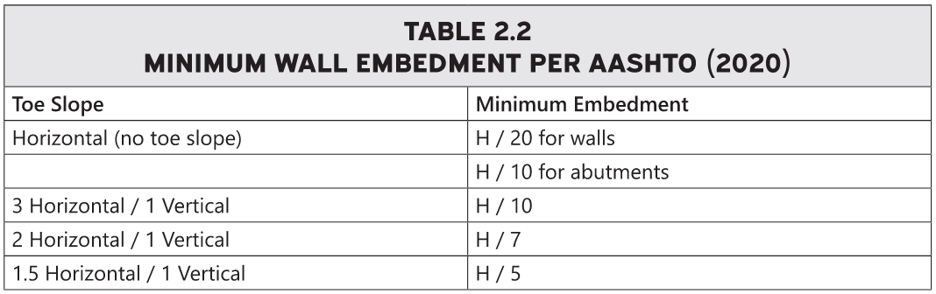
Design Inputs
Information Required to Design a Wall
  Embedment - PMB walls are designed with a minimum amount of “embedment” or bury on the bottom of the wall and aids in.
    Bearing Resistance
    Settlement
    Stability.

Slide 20
What loads act on a wall?

Slide 21
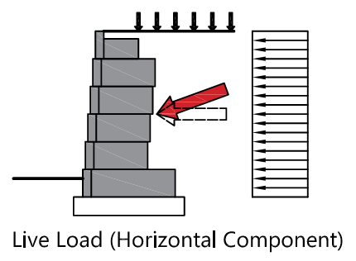
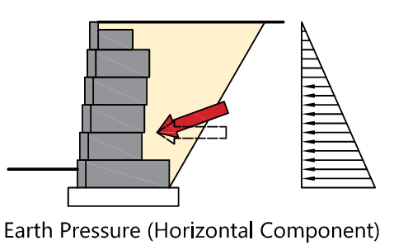
Loads on the Wall
PMB Gravity walls use the weight of the wall to support retained soil and any additional loads. It can be useful to describe forces acting on the wall as either stabilizing or destabilizing.
  Destabilizing Forces - Forces that act on the wall and attempt to move it. They include
    Supported earth (horizontal component)
    Surcharge loads (horizontal component)
    Weight of supported structures (horizontal component)
    Tiered wall systems

Slide 22
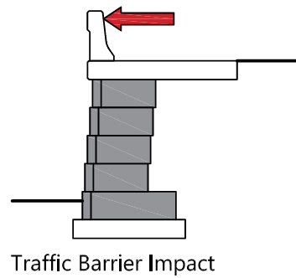
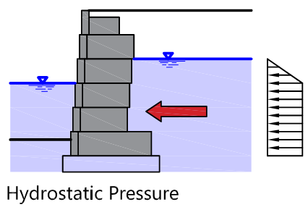
Loads on the Wall
  Destabilizing Forces - Continued
    Hydrostatic pressure
    Impact loads from traffic barriers
    Seismic loads
    Forces from fences and railings that are supported by the wall

Slide 23
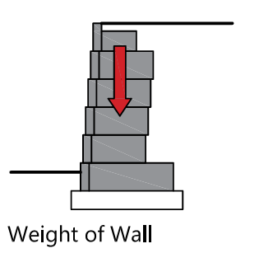
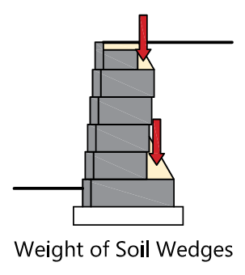
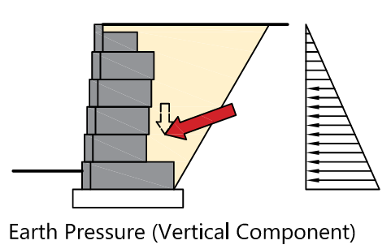
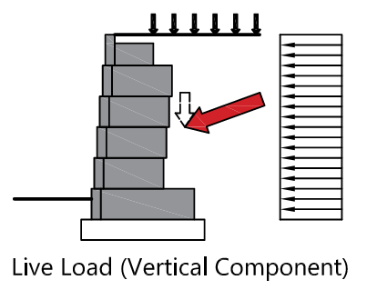
Loads on the Wall
  Stabilizing Forces - Forces that act on the wall and work to keep it in place. They include.
    Weight of PMB units (including any infill material)
    Weight of supported soil wedges that act with the PMB units
    Supported earth (vertical component)
    Surcharge loads (vertical component)

Slide 24
Loads on the Wall
Determination of Earth Pressure Acting on a Wall
  The single most significant factor impacting the design of a retaining wall is how much pressure the retained soils exert on the wall. The most common methods for determining this pressure include
    Equivalent Fluid Pressure
    Rankine
    Coulomb
    Log-Spiral Failure Wedge
    General Limit Equilibrium
  For most applications, Coulomb is used to calculate active earth pressure and Rankine is used to calculate passive earth pressure.

Slide 25

Loads on the Wall
Determination of Earth Pressure Acting on a Wall
  Rankine Earth Pressure Theory
    In 1857, Scottish engineer William Rankine developed the theory.
    Rankine’s theory of plastic equilibrium was expanded to determine the earth pressures acting on retaining walls.
    In the case of the wall deflecting slightly away from the soil, the soil is said to be in the active condition. The coefficient of active earth pressure, k_{A}, can be defined as:
where
Φ’ = effective internal friction angle of the soil

Slide 26

Loads on the Wall
Determination of Earth Pressure Acting on a Wall
  Rankine Earth Pressure Theory
    When the wall is forced into the soil (and the horizontal stress in the soil is greater than the vertical stress), the soil is said to be in the passive condition. The coefficient of passive earth pressure, k_{P} can then be defined as:
where
Φ’ = effective internal friction angle of the soil

Slide 27
Loads on the Wall
Determination of Earth Pressure Acting on a Wall
  Coulomb Earth Pressure Theory
    In 1776, prior to Rankine’s work on plastic equilibrium, Charles Coulomb developed a method to compute earth pressures acting on retaining walls.
    Coulomb assumes a linear failure plane and a linear ground surface. It explicitly accounts for
      Friction between the soil and wall
      Can account for sloping backfill
    Similar to Rankine’s theory, Coulomb’s theory requires that the wall move sufficiently to mobilize the shear strength of the soil.

Slide 28
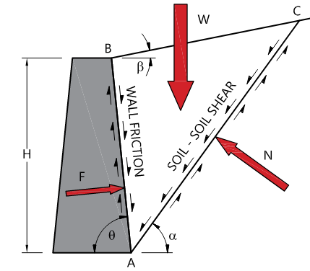
Loads on the Wall
Determination of Earth Pressure Acting on a Wall
  Coulomb active failure condition assumes the following for a cohesionless soil
    An assumed failure plane behind the wall at an angle α
    The weight of the wedge of soil (W).
    The weight of the soil wedge is resisted by the soil below the failure plane and by the wall.
    For the wedge to form, the soil must fail in shear along the plane defined by the angle α.
    Coulomb also considers friction between the back of the wall and the retained soil.

Slide 29
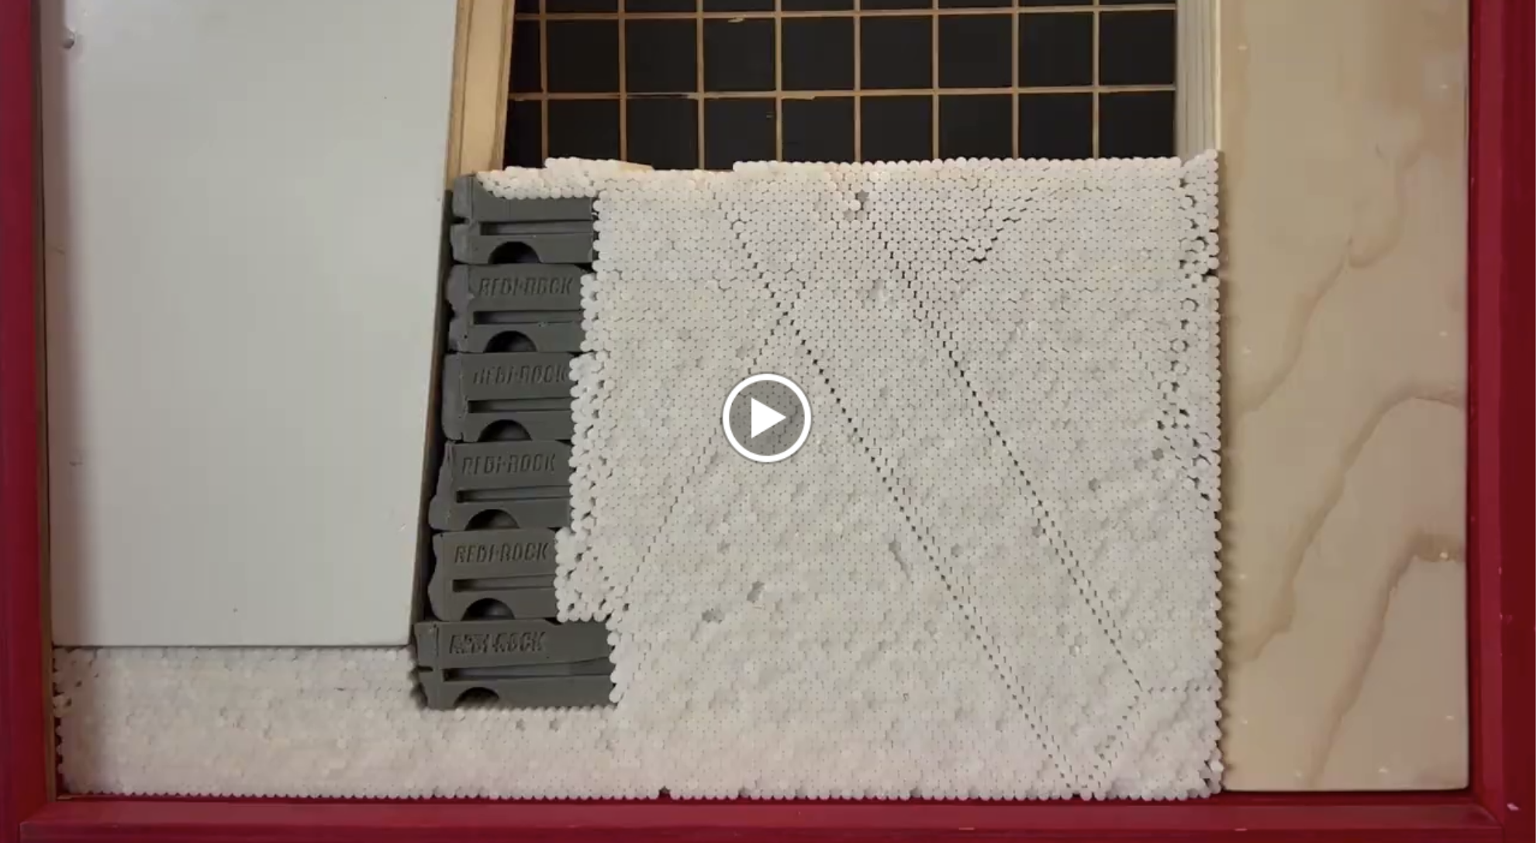

Slide 30
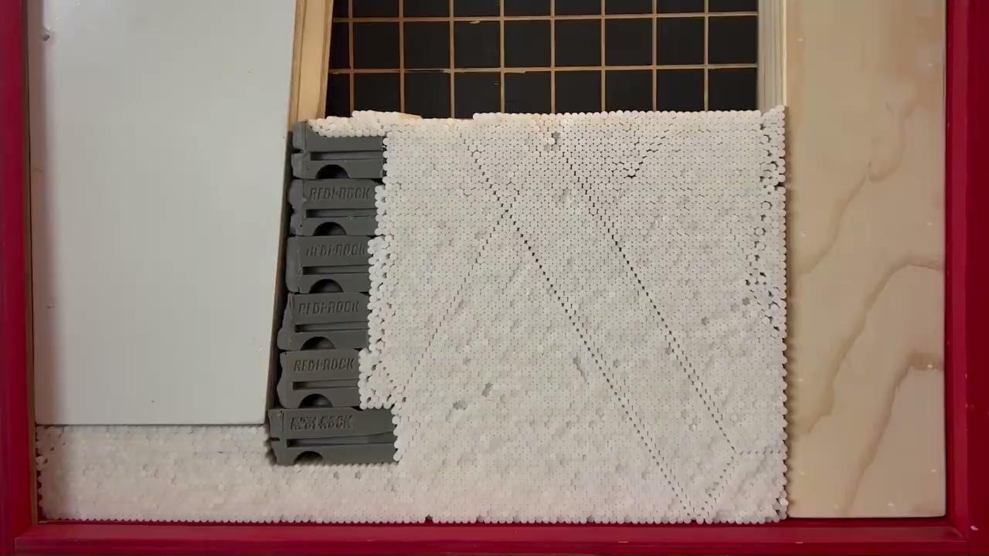
Notes:
Formation of the Active Wedge failure plane

Slide 31
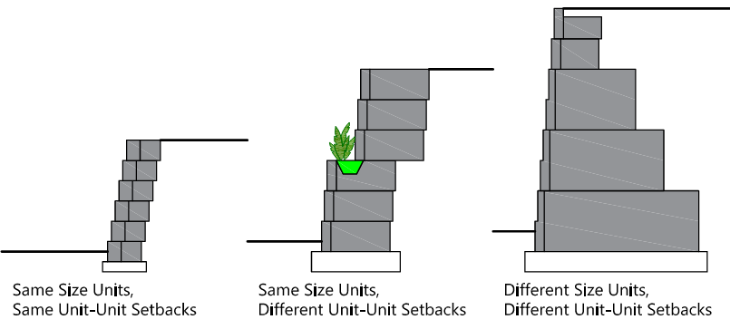
Loads on the Wall
Back-of-Wall Location
  The earth pressure theories presented above all assume a back-of-wall condition.
  PMB walls can have different back-of-wall conditions and the designer needs to decide how to best approximate the back of wall to determine earth pressures.

Slide 32
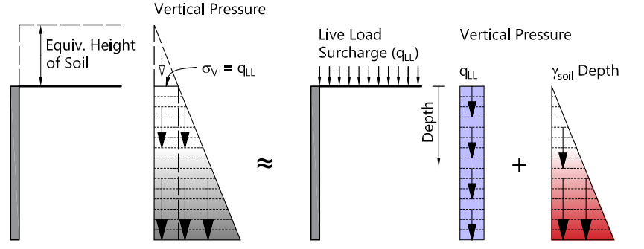
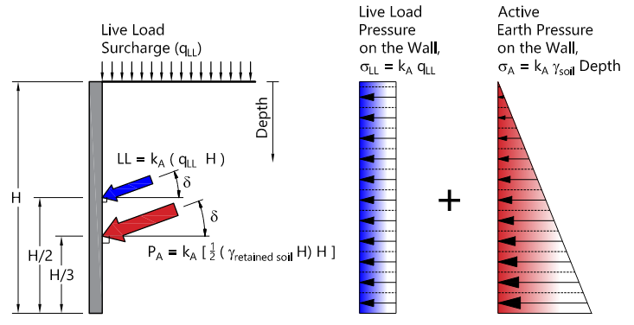
Loads on the Wall
Surcharge Loads
  Uniform Loads
    If the loading is spread out enough that it may be considered continuous, surcharge loads can be accounted for by approximating them with an equivalent height of soil.
      Coulomb earth pressure coefficients can be used to convert the vertical pressure to force on the retaining wall.
    Although an equivalent height of soil is used to include the effect of surcharge loads, common practice is to separate the earth pressure and the surcharge loading in design calculations.

Slide 33
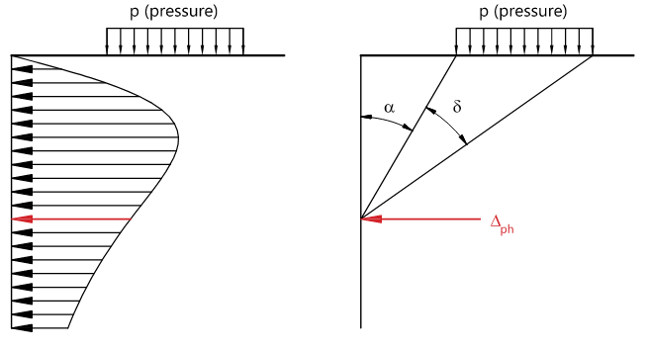

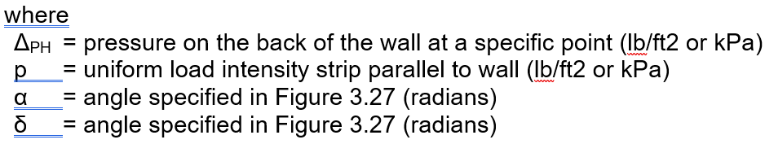
Loads on the Wall
Surcharge Loads
  Offset Loads
    Loads that are offset from the wall are not continuous and are not easily modeled with an equivalent height of soil. It is very common for wall designers to use Boussinesq Theory to convert strip, line, and point loads to lateral pressures.

Slide 34
Loads on the Wall
Surcharge Loads
  Offset Loads
    Several items to note:
      The Boussinesq equation is based on the theory of elasticity. It should not be confused with Rankine and Coulomb earth pressures which are based on the theory of plastic equilibrium.
      The active earth pressure coefficient k_{A} is not used.
      Forces are not assumed to act at the angle δ to the back of the wall.
      The equation above is based on rigid, unyielding walls and may be very conservative for more flexible PMB walls.
Notes:
An alternate approach to using the Boussineq equation when determining the impact of offset strip loads on the wall would be to use a graphical Coulomb solution. Which is described in the PMB Manual

Slide 35
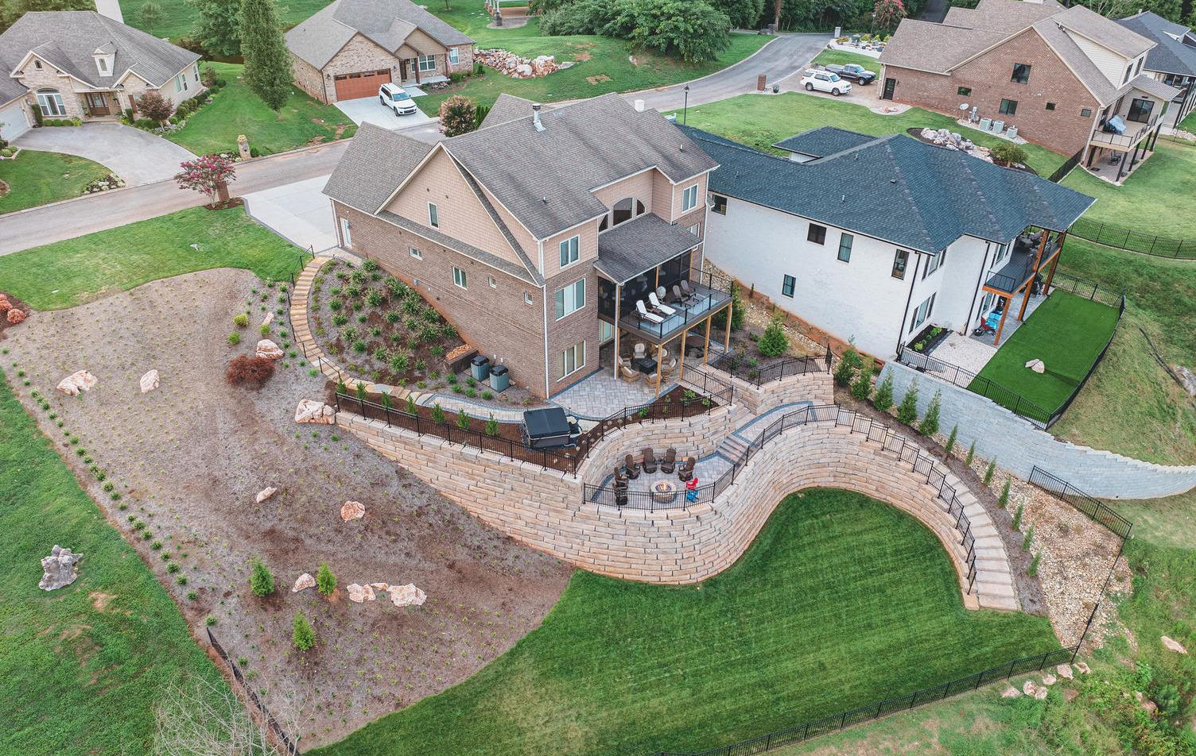
Loads on the Wall
Surcharge Loads
  Other Loads
    Hydrostatic Loads
    Seismic Loads
    Barrier Loads
      Pedestrian Handrail Loads
      Fences
      Post-and-Beam Guardrails
    Traffic Barriers for Highways
    Buildings and Other Structures
Notes:
All of theses are described in design manuals

Slide 36
How do I analyze the stability of a wall?

Slide 37
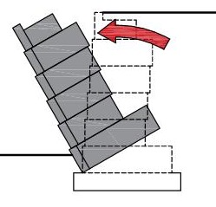
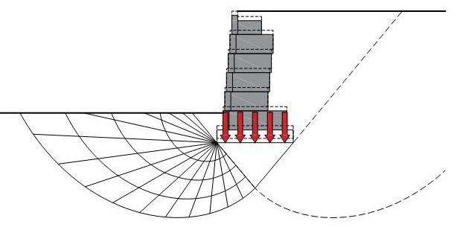
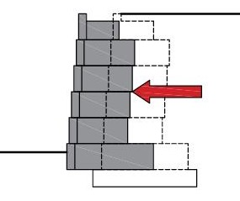
Stability Analysis
Modes of Failure
  PMB walls use the weight of the PMB blocks and any supported soil wedges to resist destabilizing forces. Stability of the wall is analyzed by evaluating potential modes of failure. Stability can be classified as external, internal, or overall.
    External stability evaluates the entire wall section. Potential external stability failure modes that must be evaluated include sliding of the wall (A), overturning of the wall (B), and bearing capacity failure of the foundation soils (C).
(A)
(B)
(C)

Slide 38
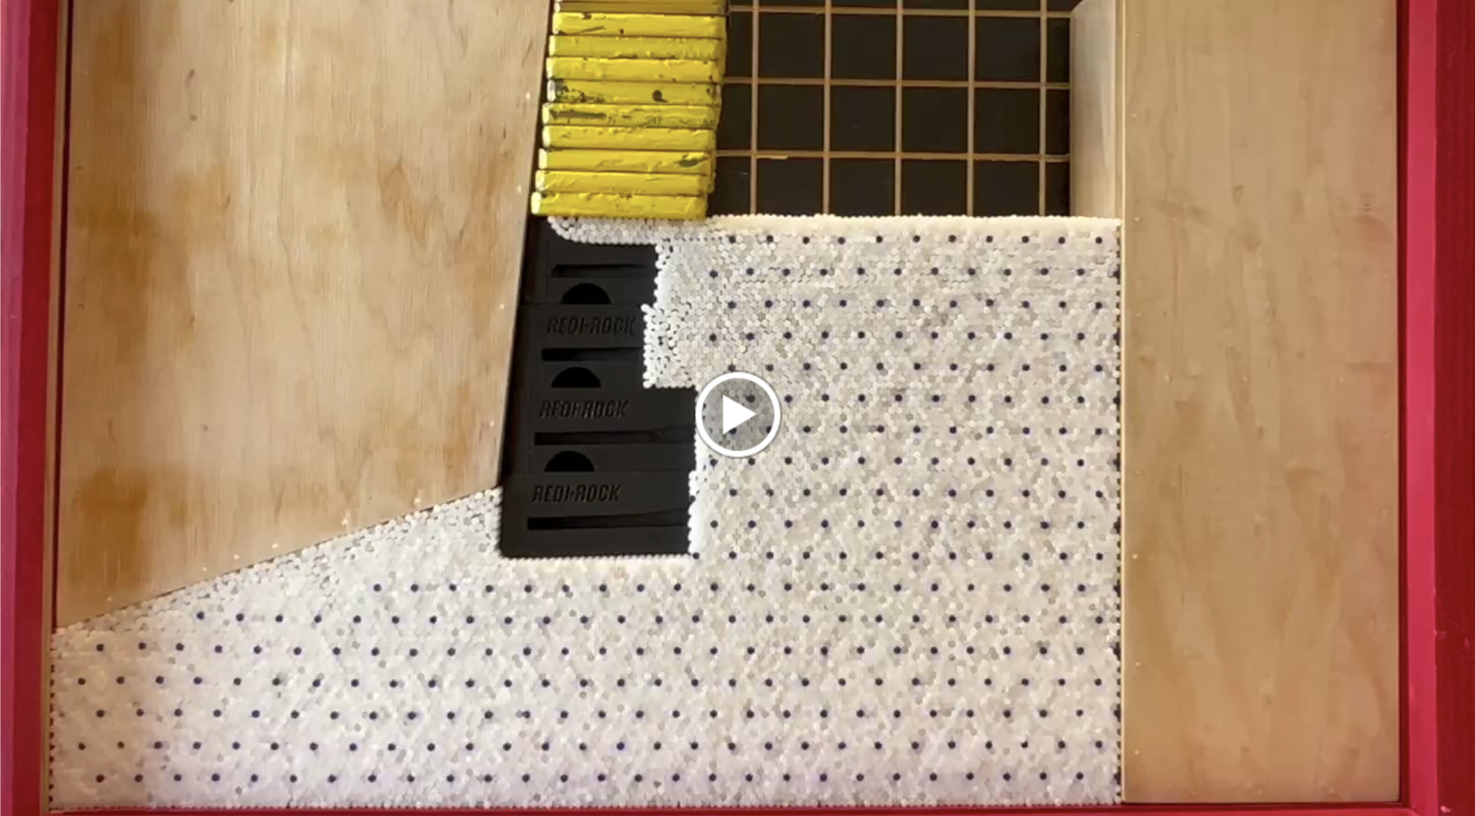

Slide 39
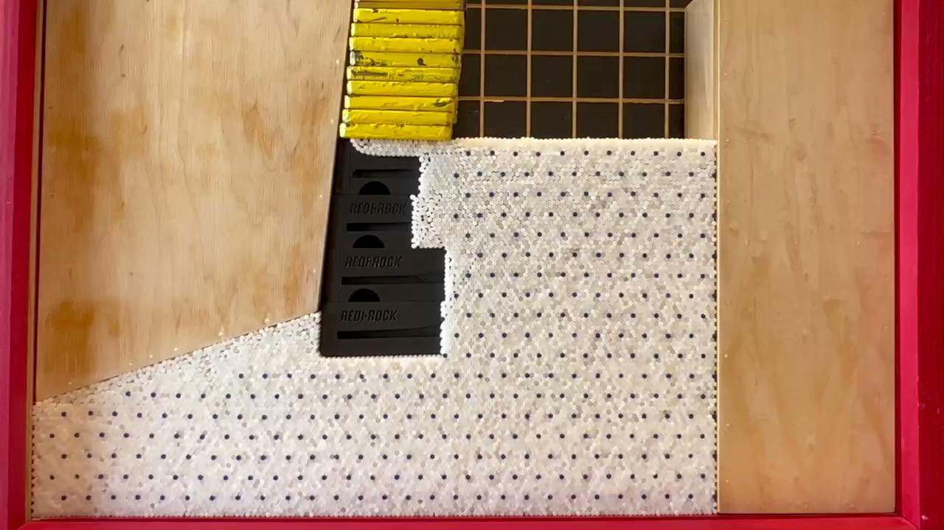
Notes:
Initial bearing capacity failure then overturning failure

Slide 40
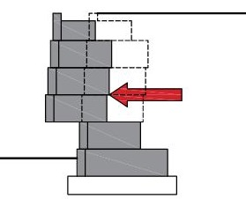
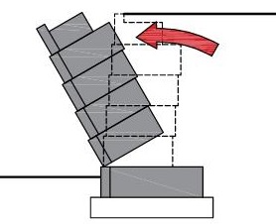
Stability Analysis
Modes of Failure
  PMB Walls are made from discrete units and are not solid or rigid structures. As a result, stability needs to be analyzed at each row of PMB units.
    Internal stability evaluates each section from that particular row of PMB units to the top of the wall. Potential internal stability failure modes that must be evaluated include sliding between rows of PMB units (D) and overturning of the upper section of a wall (E).
(D)
(E)

Slide 41
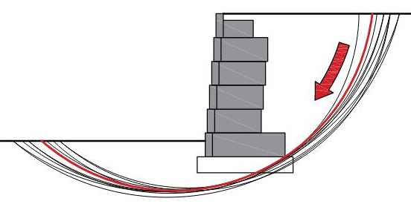
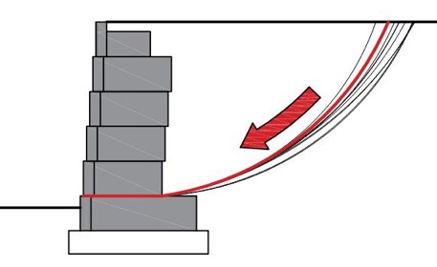
Stability Analysis
Modes of Failure
    Overall stability is also commonly referred to as “global stability” (F). Overall, or global stability evaluates the entire slope containing the wall. Potential overall stability failure modes include failure of the slope below, behind, and above the retaining wall. A subset of overall stability calculations is called “internal compound stability” (G) and considers failure of the slope above the wall, with the failure surface passing through the wall.
(F)
(G)

Slide 42
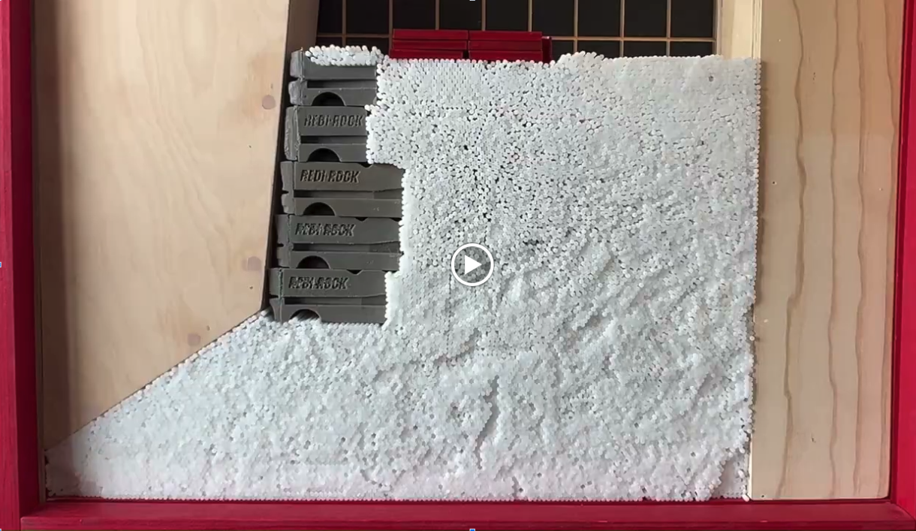

Slide 43
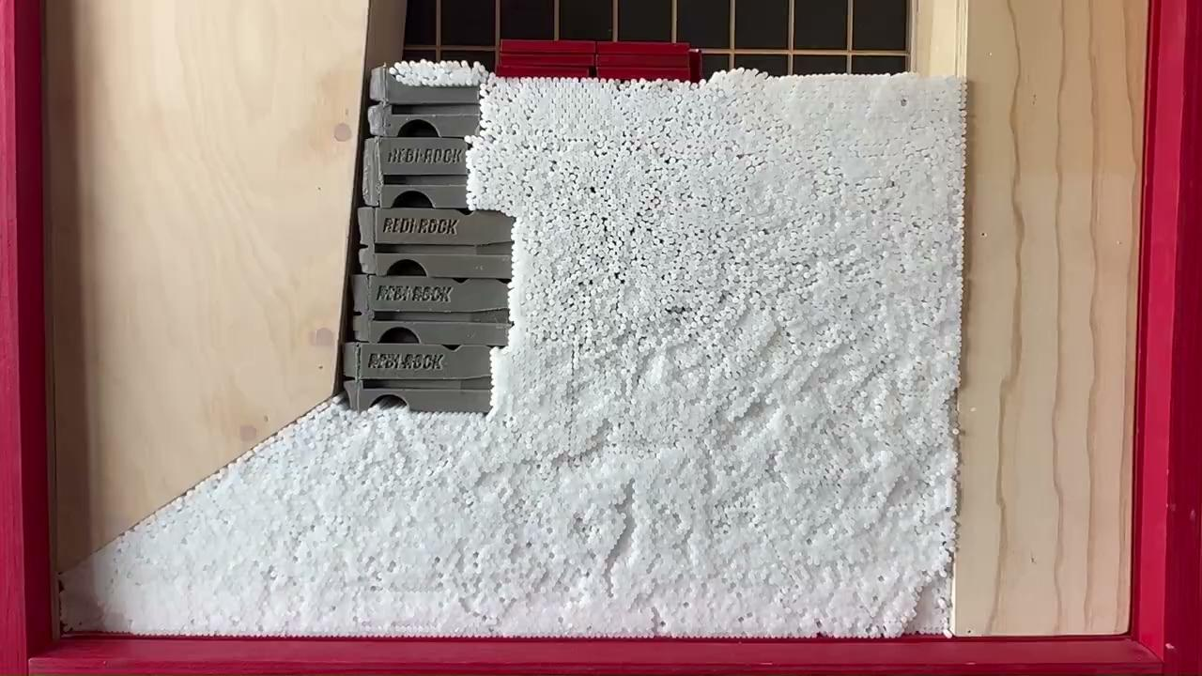

Slide 44
Stability Analysis
Allowable Stress Design and Load and Resistance Factor Design
  When performing a stability analysis, the wall designer must establish criteria to determine if the proposed wall is acceptable to resist the forces that will be acting on it and estimate the reliability of the analysis. The two methods used are
    Allowable Stress Design (ASD)
    Load and Resistance Factor Design (LRFD).
  Nominal loads and forces, such as the weight of the PMB units and earth pressure force acting on the wall, are calculated for both cases. The difference between ASD and LRFD is what the designer does with the nominal loads.

Slide 45
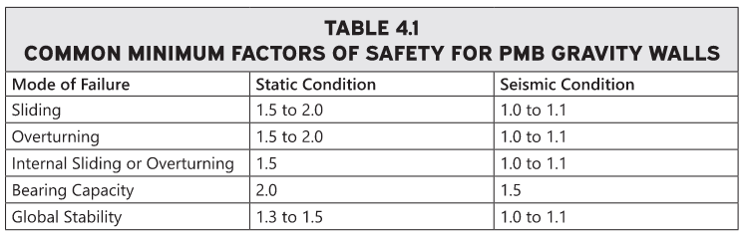
Stability Analysis
Allowable Stress Design and Load and Resistance Factor Design
  In Allowable Stress Design, nominal values of the stabilizing forces or moments are divided by nominal values of destabilizing forces or moments to determine a Factor of Safety (FS). If the calculated FS is greater than a minimum value, the wall is considered acceptable to resist that particular failure mode.
  Commonly accepted factors of safety for gravity walls has been established and are listed below.

Slide 46
Stability Analysis
Allowable Stress Design and Load and Resistance Factor Design
  In Load and Resistance Factor Design, statistically-derived factors are used to both increase the loads acting on a wall and reduce the resistance provided by the wall.
  Factored loads are divided by factored resistances to determine a Capacity Demand Ratio (CDR). If the CDR is greater than one, the wall is considered acceptable to resist that particular failure mode.
  In wall design, LRFD is further complicated by the fact that select load factors have maximum and minimum values. This requires that stability analyses be conducted for all possible combinations of load factors.

Slide 47
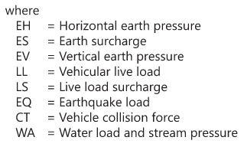
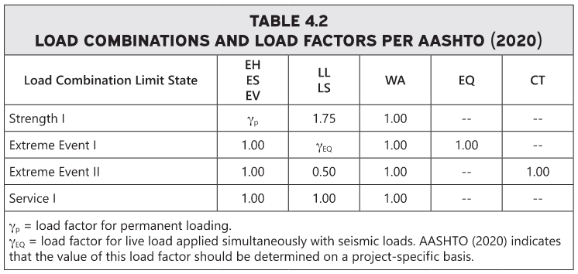
Stability Analysis
Allowable Stress Design and Load and Resistance Factor Design
  LRFD - Load and resistance factors are available in AASHTO (2020) and FHWA (2009). Example load combinations are provided below.

Slide 48

Stability Analysis
Bearing Capacity
  Equations to calculate bearing capacity of foundation soils have been developed by Terzaghi, Meyerhof, and others. The basic form of the equation is below.
  Wall designers often make the following assumptions:
    The wall acts like a strip footing and the resulting shape factors are 1.0.
    The impact of inclined loads has little effect on the bearing capacity and is ignored.
    The water table is not located in close proximity to the wall.
  For walls that do not have a toe slope below the bottom of the wall, no reduction in bearing capacity due to proximity to a slope is made. As a result, the above equation can be simplified and the bearing capacity of the foundation soils can be calculated as follows:
Notes:
The PMB Manual provides more information for walls near a toe slope

Slide 49
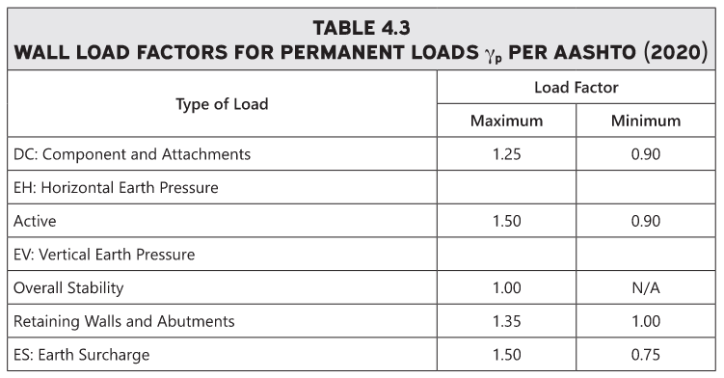
Stability Analysis
Allowable Stress Design and Load and Resistance Factor Design
  LRFD - Load factors are provided below.

Slide 50
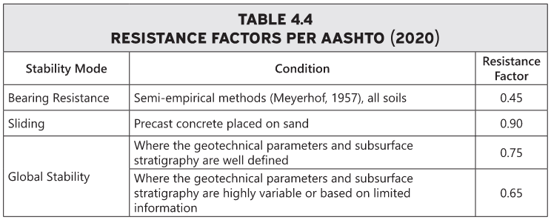
Stability Analysis
Allowable Stress Design and Load and Resistance Factor Design
  LRFD - Resistance factors are provided below.

Slide 51
Stability Analysis
External Sliding Stability
  External sliding stability calculations are performed to ensure the wall is substantial enough to keep from being moved by the supported soil and any other applied loads.
  Driving forces that would cause sliding typically include
    The horizontal component of the earth pressure force
    The horizontal component of the force from supported surcharge loads.
    Other less common driving forces may include
      water pressure
      pedestrian loading on handrails
      Impact forces from vehicle barriers
      Earthquake loads.
  Sliding is resisted by
    Friction
    Shear strength of the foundation soils

Slide 52
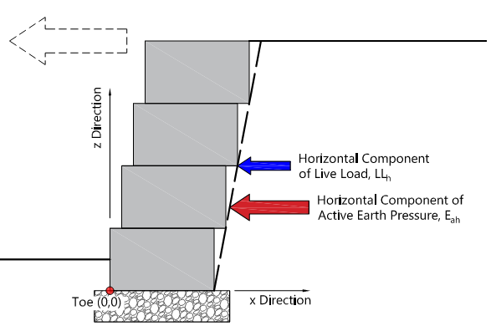
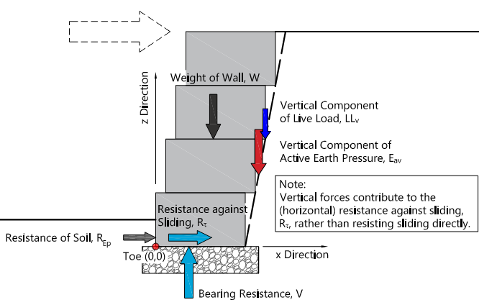
Stability Analysis
External Sliding Stability
  Example wall
Forces that produce sliding
Forces that resist sliding

Slide 53


Stability Analysis
External Overturning Stability
  External overturning stability calculations are performed to ensure the wall is big enough to keep from being tipped over by the supported soil and any other applied loads.
  In overturning calculations, we determine overturning and resisting moments separately. Standard practice in wall design is to ignore bearing resistance forces acting on the wall from the supporting soils when performing the external overturning stability analysis.

Slide 54

Stability Analysis
Eccentricity
  Eccentricity and overturning are related concepts. For a wall to keep from moving, the vertical loads are resisted by an equal and opposite force provided by the foundation soils.
  If we include bearing resistance of the foundation soils in addition to overturning and resisting moments, we can determine the distance from the center of the wall that the bearing resistance force has to act for the sum of moments to be zero and prevent the wall from rotating.
  This distance from the center the wall to the bearing resistance force is called eccentricity.
  Some wall designers will use an eccentricity limit instead of overturning to evaluate stability. AASHTO (2020) requires the resultant bearing resistance force to be located within the middle two-thirds of the base width

Slide 55
Stability Analysis
Bearing Capacity
  Bearing capacity checks to determine whether or not the foundation soils will adequately support the wall.
  Analysis of footings subject to both vertical load and moments. Pressure distribution under the footing is trapezoidal in shape, with the overturning moment producing higher pressures on one end of the footing.
  Some analyses will simplify this by approximating the pressure as a rectangular shape and applying it over a reduced portion of the footing. The reduced width or effective footing width at the bottom of the retaining wall is calculated with the following equation.
B’ = B - 2 e
where
B’ = effective footing width at the bottom of the bottom PMB unit (ft) or (m)
B = width of the bottom PMB unit (ft) or (m)
e = eccentricity of the bearing resistance loads (ft) or (m)

Slide 56

Stability Analysis
Bearing Capacity
  The total vertical loads on the wall are applied over the reduced footing width to calculate a uniformly distributed vertical stress at the bottom of the PMB units.
  The vertical stress at the bottom of the units (σ_{V}) is transferred through the granular leveling pad and acts on the foundation soils. It is commonly assumed that the stress spreads through the stone at an angle of 1 horizontal to 2 vertical.

Slide 57

Stability Analysis
Settlement
  PMB walls that are built upon well compacted, coarse grained soils are typically not subject to significant settlement and their modular nature generally allows them to tolerate modest amounts of displacement.
  As such, settlement calculations are not often performed for PMB walls. Should concerns persist, I would refer you to a geotechnical engineer for settlement analysis.
Internal Stability
  Internal stability calculations are similar to external stability calculations; however, instead of starting at the bottom front corner of the lowest PMB unit, calculations start at the bottom front corner of the remaining PMB units from row 2 to the top of the wall.

Slide 58
Stability Analysis
Sliding
  Driving and resisting forces are only calculated for the portion of the wall under evaluation in the particular internal stability check. Any pressure below the bottom row of PMB units being considered is neglected.
  Resistance to sliding is produced by block-to-block interface shear.
  Depending on the PMB unit, resistance may be generated from
    Interlocking features
    Friction between PMB units
    Resistance to shear in granular core fill material.
  Design values of interface shear to resist sliding between units are obtained from full scale lab testing of the units. ASTM D6916 Standard Test Method for Determining the Shear Strength Between Segmental Concrete Units (Modular Concrete Blocks) is followed in most PMB block-to-block interface shear testing.

Slide 59

Stability Analysis
Sliding
  Here is an example of a PMB manufacturers published results of block-to-block interface shear testing.

Slide 60
Stability Analysis
Overturning
  For internal stability checks, overturning is calculated for each row from that row to the top of the wall.
  Even if the external stability for overturning is adequate, it is possible that the upper portion of the wall may be unstable or fail to possess the minimum desired level of reliability.

Slide 61
Stability Analysis
Global Stability and Internal Compound Stability
  Overall, or global stability, evaluates the entire slope containing the wall using a limit equilibrium analysis such as Bishop’s method.
  Global stability calculations evaluate hundreds of potential failure surfaces to determine which produces the minimum factor of safety. Computer programs such as those below are used to perform these evaluations.
    GEO 5 Slope stability
    Slide
    XSTBL
    Slope/W
  The design engineer of record for the wall must perform global stability calculations, unless specified otherwise.

Slide 62
Details & Best Practices for Walls

Slide 63


Detailing
Overview
  Proper wall design demands more than simply performing stability calculations. Often, it is specific construction details included in the design that will cause a PMB wall project to be successful or not.
  The following list contains several details that should be included in every design, some that are specific to a particular project, and the list is likely missing specific details that may be required for a very complex project.

Slide 64


Detailing
Details
  Running Bond
  Leveling Pad
    Aggregate
    Unreinforced Concrete
  Drains
  Slopes
    Sloping Grade Parallel to the Wall
    Sloping Grade Perpendicular to the Wall
  Barriers
    Rails and Fences
    Traffic Barriers
      Post-and-Beam Guardrail
      Concrete Parapet Wall with Moment Slab
      Parapet Walls and Moment Slab that Incorporate PMB Units

Slide 65


Detailing
Details (Continued)
  Curves and Corners
  Utilities and Culverts
    Dry Utilities
    Wet Utilities
    Pipes Installed Through the Wall
    Culvert Headwalls
    Vertical Slip Joint
  Ect.

Slide 66

Best Practices
Topics
  Geotechnical Site Investigation
  Design Parameters
  Site Grading, Alignment, and Utilities
  Cost Estimating
  Selecting a Retaining Wall Design Engineer
  Engineering Design
  Construction

Slide 67

Best Practices
Engineering
  When should you consider engaging an Engineer
    Changeling sites
      Tiered walls
      Tall walls
      Etc.
    Water conditions
    Local requirements

Slide 68

Best Practices
Engineering
  What are the benefits from obtaining an engineering design for a wall
    Provide detailed construction plans for the wall
    Help identify any challenging construction issues
    Alleviate some of the risk associated with the project
    Provide a resource for answering issues or questions that arise during construction

Slide 69

QUESTIONS?

